Slide 1

An Explainable AI Assistant
toot your problems away

Slide 2
Table of Contents
01
Introduction and Summary
02
The Product
A short introduction and the context of our proposal.
The main features of our product are described here, including a focus on the context of privacy.
03
The Team
04
The Market
A brief description of our team: who we are, our background and our role within the team.
This section aims to explain to whom we are solving this problem, together with a description of our competitors and a growth prediction.
05
06
Our Vision and Mission
Pricing and Revenues
This section contains an overview of our costs, pricing scheme and revenues forecasts, considering different scenarios. It contains also a SWOT analysis.
Our philosophy and vision are described here.

Slide 3


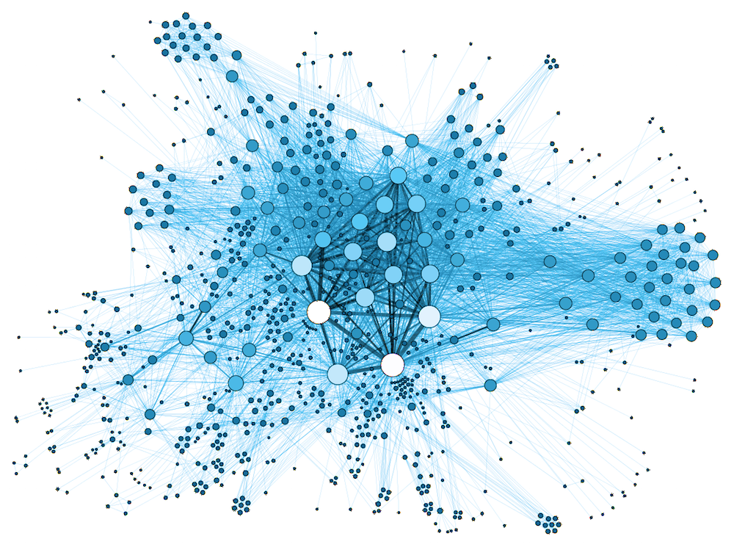
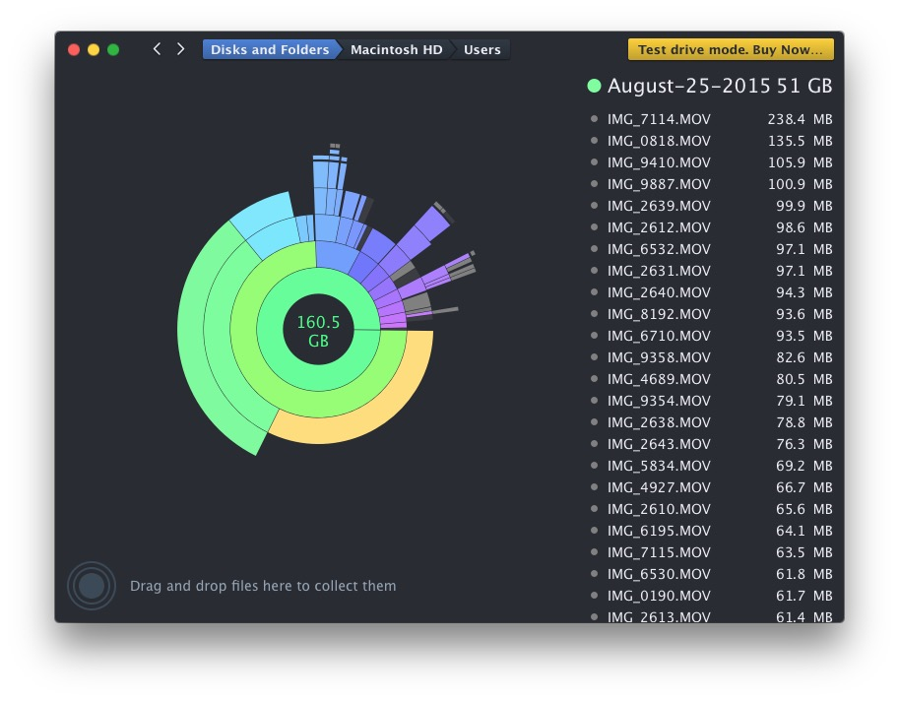
Introduction and
Summary
The Problem Domain
Our Solution

Slide 4

Our problem domain
The disk space issue is experienced by IT experts that work for Managed Service Providers (MSP). Using Application Monitoring Systems, they are provided with detailed insights into the processes that are happening on the servers they are responsible for. When disk overflow errors are reported, the engineer investigates the process and fixes it with the knowledge at hand. In addition to that he is responsible for informing external parties of his issue’s progress. Because such errors can happen at any time, the experts must always be available to avoid inconvenience for the MSP’s customers due to server downtime.
Introduction
The engineer has to decide - based on the contest of the error - one among these three possible solutions:
1) Extend disk space;
2) Optimize disk space (archive/remove files);
3) Report to responsible customer (ask for confirmation/indication on which action to take).
The best possible solution for a specific error depends on many factors such as the engineer's experience, the type of customer, etc.

Slide 5
Executive Summary
Our Solution
We at toot.ai are developing AI as a service (AIaaS).
Our Virtual Employee Assistant (VEA) will focus on helping Software and DevOps Engineers automatically solve disk space issues that occur during server management.
With our solution, engineers will be able to focus on more important problems, as they will save time by letting our VEA solve the disk-space issue for them.
This document contains a summary of our whole vision, product and strategy to go to the market, as well as an analysis of our contingency factors and forecasts of possible scenarios.

Slide 6

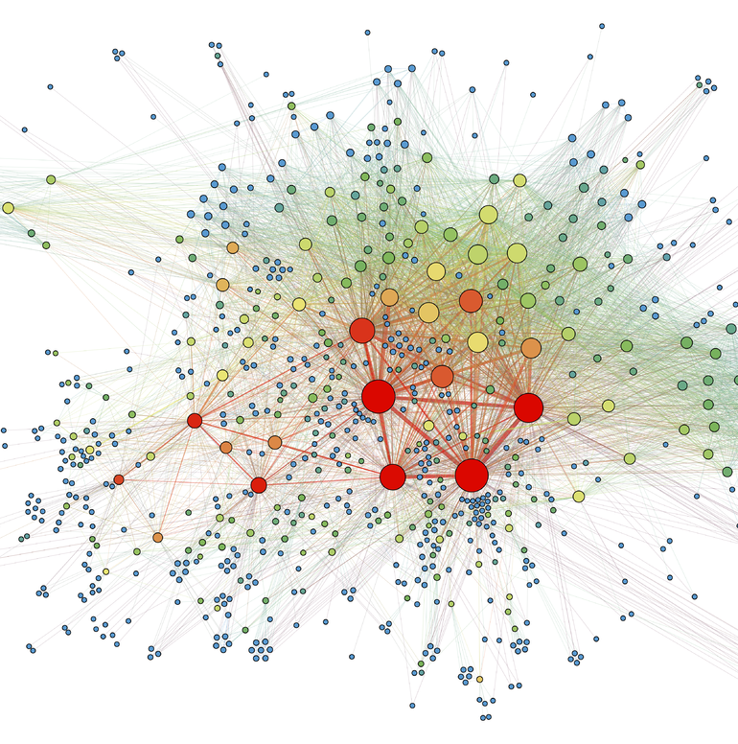

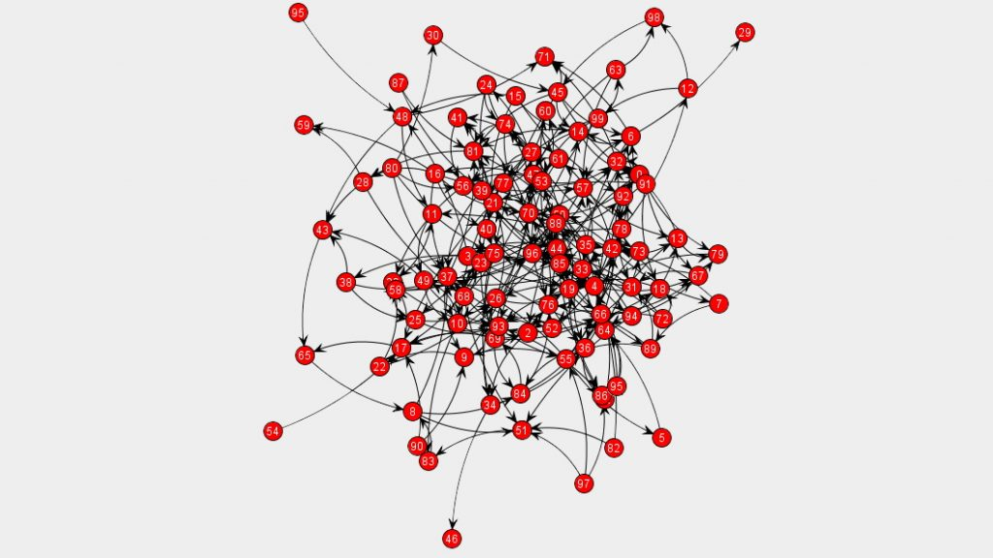
The Product
Demo
Knowledge
Core Features
Privacy

Slide 7


Slide 8
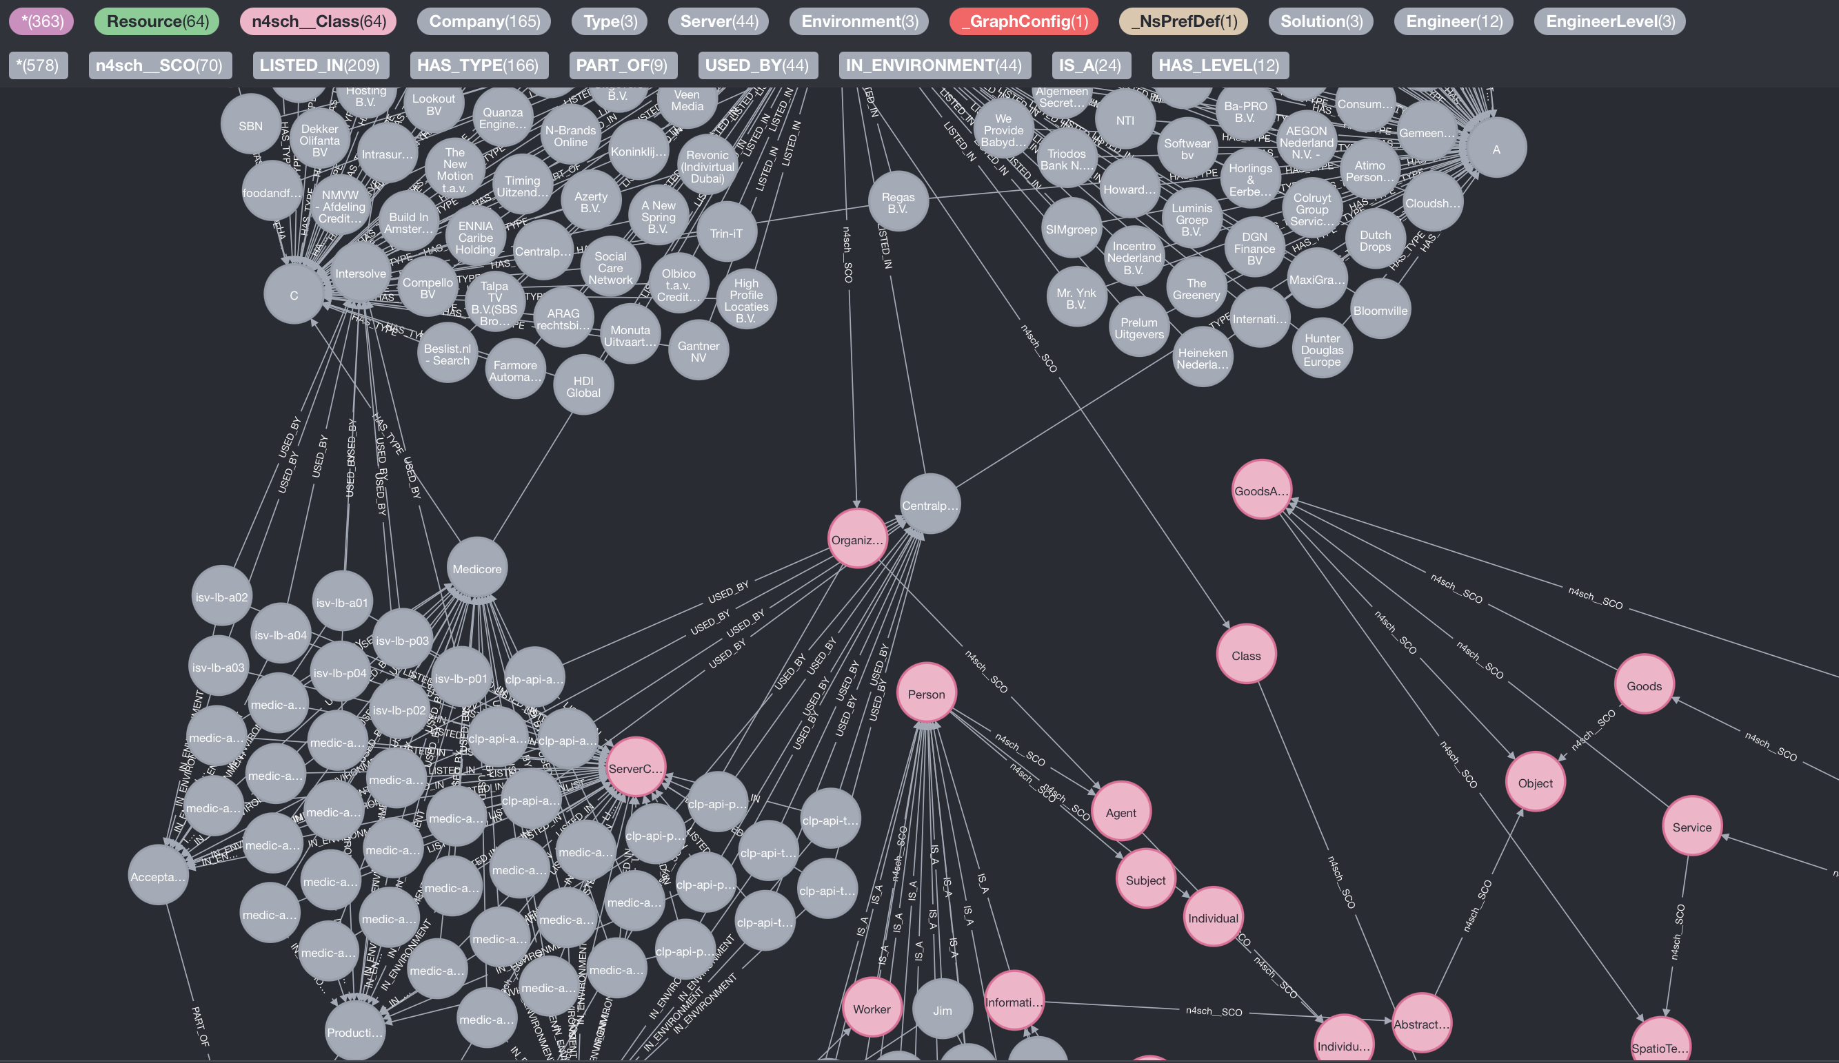
Knowledge

Slide 9
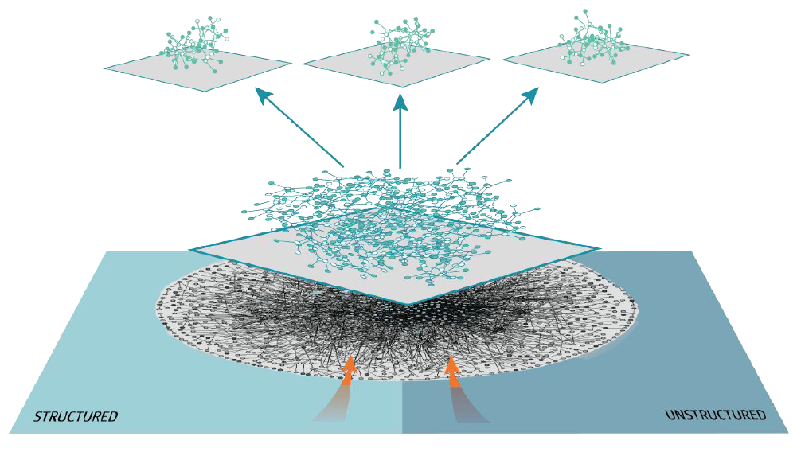
Knowledge in Layers
▲ Custom Concepts – optionally, give freedom to combine knowledge and create new concepts that expand the capacity of the knowledge base even further.
⊟ Custom Knowledge – introduce a specific and personalized data set that together with the core domain knowledge make up the environment in which toot reasons.
▼ Core Domain Knowledge – encompass all notion of the domain of knowledge, crafted by toot.

Slide 10
Core Features
Friendly UI
toot has hidden most of its complexity into the platform, interacting with it is easy.
Reasoner
toot is able to assist you in inferring new knowledge from existing knowledge and explain why.
Customizable Knowledge
toot is able to handle all personalized information with ease.

Slide 11

What about privacy?
Layered knowledge will leave you in control of your own data.
You can deploy and run the local solution offline.
You can also implement our cloud-based solution, where all personalized knowledge is closed from the outside world and only accessible by you.

Slide 12




The Team
Who We Are
Our Background
Our Roles within toot.ai

Slide 13



Daniele Di Grandi
Jim Ekanem
Otto Mättas
General Developer & Marketing & Finance
Frontend Developer &
Marketing & User Experience
Backend Developer & Vision & Investor Relations
BSc in Management Engineering
MSc in Computing Science
Experienced in Marketing, Development, Budgeting and Control
2 years of work experience
BSc in Media Informatics
MSc in Human-Computer Interaction
Experienced in Design and Frontend Development
BSc in Systems Administration
MSc in Artificial Intelligence
Experienced in DevOps, Knowledge Representation and Reasoning (KRR)
10 years of work experience

Slide 14

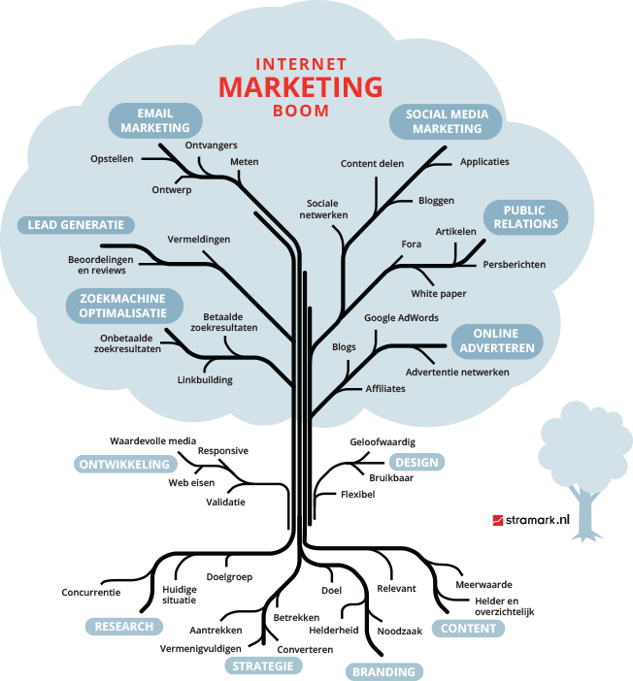

The Market
Target Market
Brief Competitors Analysis
Validation by Experts and Companies
How We Deal with Privacy

Slide 15

Target Market
Who we are targeting
Managed Service Providers Companies
We are targeting tech companies such as Managed Service Providers (MSP) to help them with managing the servers that they keep their data on. The users of our Virtual Employee Assistant are DevOps engineers that work in those companies, but also DevOps freelancer engineers in charge of maintaining and managing servers of third parties.
Future revenues from the MVP will be used to expand the product into other domains to target other markets. However, we aim to stay in the B2B market.
DevOps Freelancer Engineers
Expand in other Domains
(in B2B)

Slide 16

Competition
Market Research Results
During our market research, we have compiled a list of companies that developed products like ours. However, there is no company that sells the exact same product, that is, developed to provide a solution to the same problem we are aiming to solve.
In this document, we will provide information on the most relevant competitors that can be classified into 3 categories:
• Potential competitor: competitors that could develop a similar product, since they have a similar technology used for another product.
• Replacement competitor: competitors that sell a product or service that is both different in category and type than ours, but one which possible customers could choose to spend their money instead.
• Direct competitor: actual competitors that have a similar product to the one we are developing.
Firstly, products like Google’s assistant, Apple’s Siri, or Microsoft’s Cortana may seem similar but are not considered in our research. This is because they are in the B2C market, and their scope is to solve minor tasks for the average user.
Although their VEAs are based on a type of knowledge graph, their knowledge graphs do not have an ontology: rather than focusing on making the graph using inference rules to infer some type of solution, they limit themselves to connect objects to each other, thus describing the environment, rather than a possible action that can be taken to solve a problem. This means that these products are not meant for aggressive industrial usage, hence, they are completely different from our product, both in the scope and in the target market. However, since they have the technology in place, in the future they could develop their products for industrial usage. Therefore, we categorize those companies as potential competitors.

Slide 17




Competitors
Direct
Replacement
Direct
Replacement
Amazon CloudWatch
Splunk
Dynatrace
Datadog
The product works only if you use AWS servers. Moreover, the solution they propose is mainly a monitoring system, but can also automatically solve some issues.
They have a software to predict the future need of space on a disk. One can decide if it is better to minimize the number of errors or have the same number as before but handle them automatically.
They do not acquire information from the user itself, but only from the system environment which is running on. Moreover, their product does not handle automatically all the errors, but only some of them.
They only have an automatic monitoring system. Some customers are maybe not interested in an automatic system of error handling, but only in an error detection system.
What emerged from this analysis is that the core task of all these systems is monitoring, and not automatic error handling. Essentially, they are great solutions to detect and even predict when a disk on a server runs out of space.
But they will not be able to do much more than this!
This leaves us with a great opportunity to step in between the monitoring tools and the engineers and help them fix issues directly and automatically.

Slide 18



Market Validation
Customer expression of interest and experts’ assessment for our product
Customer expression of interest: Sentia
In our research, we have gathered a customer expression of interest, as well as 2 expert assessments and 1 opinion about a future user of our VEA, that is, an actual DevOps architecture engineer.
They manage 15.000 servers and experience errors every 10 minutes. They reported that the costs for a manual fix reach up to 50 € per issue.
Expert assessment: Full associate professor
A university professor of Informative Systems at “Politecnico di Milano” with work experience in an APM company expresses an interest in our product.
Expert assessment: Associate professor
A university professor of Computer Science at “Politecnico di Milano”, experienced in server maintenance, expresses an interest in our product.
Future user: DevOps architecture engineer at Impect
“This is a time-consuming reaction to something that shouldn't happen. Being reactive means the circumstances are choosing when you have to spend time in such a task. That's a huge problem.”

Slide 19
Market size
Actual worth
World market
$ 223 billion globally
(source: Statista)
80.000 MSP and Cloud companies
(source: compubase)
World
Worth
European market
Future worth
38.000 MSP and Cloud companies
(source: compubase)
2021
Market size
$ 350 billion globally by 2025
(source: Statista)
Europe
Future
We managed to find the size of our target market. Since we want to initially focus only on the European market, we will take that number as a reference, but for the sake of completeness, we also have reported the global market size.

Slide 20
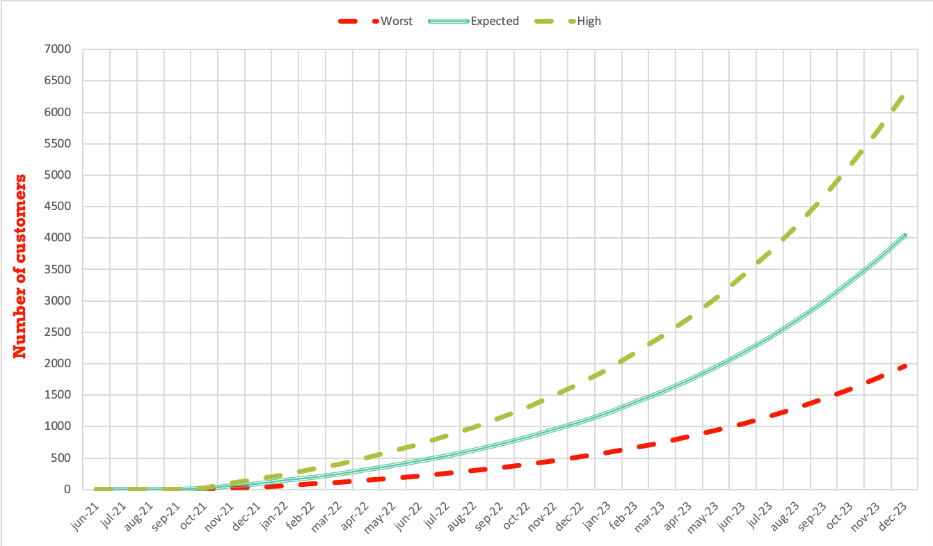
Growth predictions by Experts
SALES PREDICTION | Full associate professor | Associate professor | DevOps engineer
Month 1 after launch | 8 | 5 | 10
Month 2 after launch | 20 | 30 | 50
With the data gathered until now - including the sales predictions by experts - we can use the “Bass-sir model for diffusion of new products” to compute our future growth in terms of number of customers by considering three different sales scenarios:
Worst (consider the minimum predictions)
Expected (consider the average predictions)
High (consider the maximum predictions)
The prediction for the first 4 months are 0 customers, since as we will see later, those months will be fully dedicated to the Beta testers.
To use the Bass-sir model we had to define some parameters, which those values are given here:
Imitation coefficient: 10%
Spontaneous purchase coefficient: 0.05%
Market size: 38.000 companies (European market)

Slide 21




Pricing and
Revenues
Cost Structure
Pricing Scheme
Revenues Streams
Profits
SWOT Analysis

Slide 22
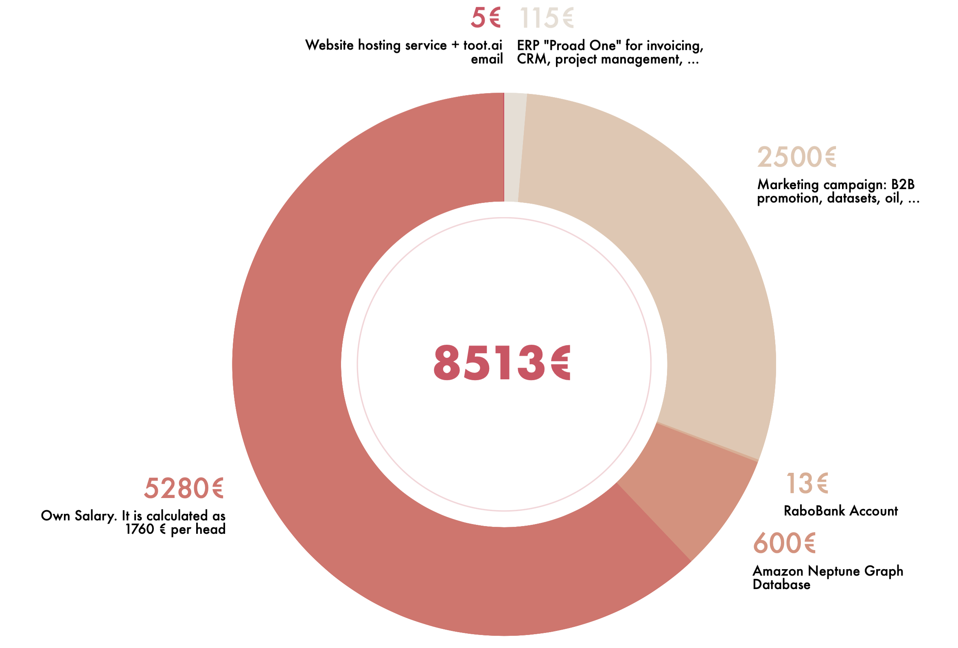
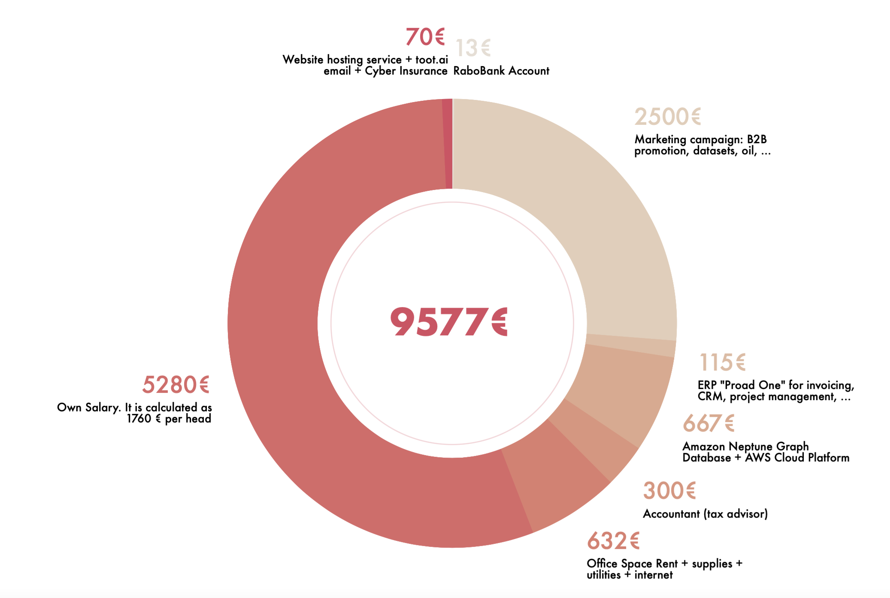
Monthly Cost Structure
Not fully operational costs
This chart shows our monthly costs for the first year, where we assume that we don’t need to have several costs, as we are a Start-Up and we can exploit several benefits.
Fully operational costs
Eventually, after the first year, we would need an office to work in, an insurance, and we should start paying the AWS Cloud Platform services, which were free for the first year. Moreover, we would need a tax advisor for managing prime entry, VAT, prepayments and accrued income etc.

Slide 23
Pricing model
Subscription based
 | Entry Plan
 | 42 €/month
 | Inference engine Access to the knowledge graph and ontology Limited customization
 | Middle Plan
 | 65 €/month
 | All the features in the Entry Plan Complete customization of knowledge graph Voice-activated UI
 | Seasoned Plan
 | 136 €/month
 | All the features in the Middle Plan Personalized customer service Priority ticket on solving problems
As is usual in the software development for MSP companies, we use a monthly subscription pricing model. We calculated our prices using the Break-even method (since it’s best for our penetration pricing strategy) and it is important to notice that all our prices are cheaper than the competition, since we initially want to build a solid customer base. Moreover, most of the competition require those prices per host, while with our product, the customers don’t have to buy any host license, hence, they could use our product on a number of different computers without paying surplus costs.
Three plans
Different needs meet different solutions: we have 3 different plans, each with different features. The more the price, the more the features you get.
Good Deal
Best Deal
Good Deal

Slide 24

Beta testers and first six months
 | Entry Plan
 | 29 €/month
 | Middle Plan
 | 45 €/month
 | Seasoned Plan
 | 95 €/month
Beta testers
To these users we will give the complete version of our product for free, such that both us and the tester customers will have a benefit: they will obtain a free product to use and maybe retain and we will obtain valuable feedback to improve the product. Beta testers have 4 months to test the product and report to us all their opinions.
42
€/month
65
€/month
136
€/month
First six months sales
After the Beta tester users, the product will be sold for the first six months with an additional 30% discount on all the plans.
After this period, the normal prices will be applied again.
Good Deal
Best Deal
Good Deal

Slide 25
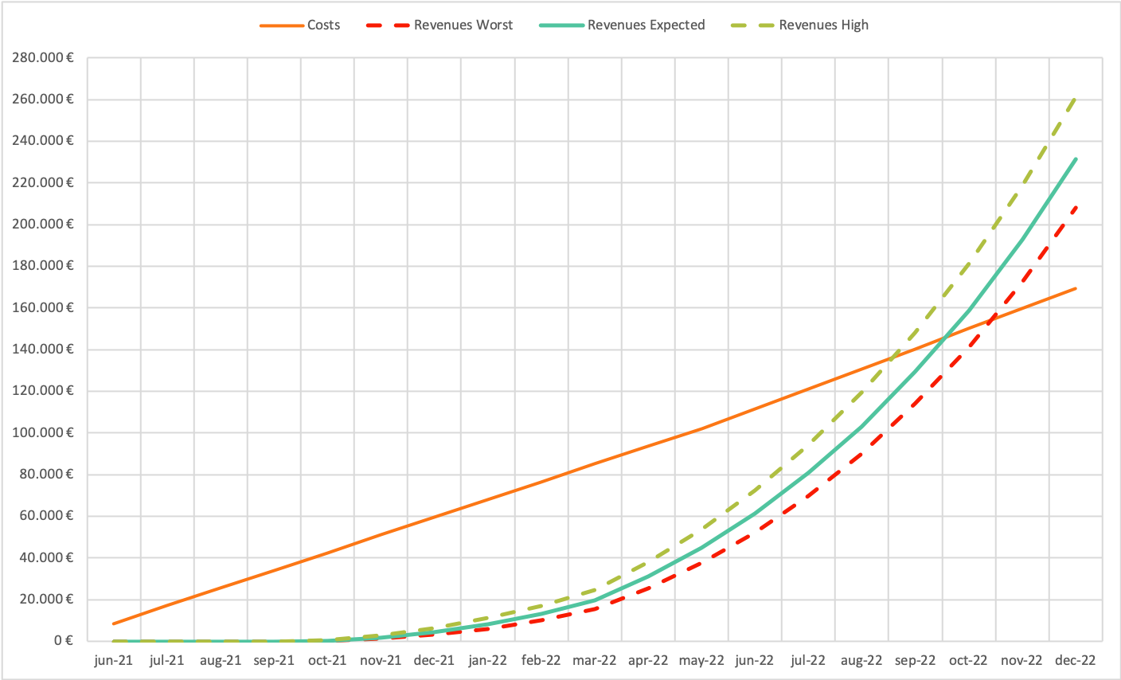
Costs and Revenues Streams
Different Scenarios
The chart on the side shows our cumulative costs and cumulative revenues streams in different scenarios. The costs are obviously the same for each scenario, while the revenues streams are considered to be different based on the number of customers that we are able to obtain, using as a base the growth predictions made by experts and seen in the Market section of this document. Moreover, we assumed that 15% of customers will buy the Entry plan, 75% will buy the Middle plan and 10% will buy the Seasoned plan.
This graph already consider all the strategies explained until now, which comprehend the initial Beta testing phase, the 30% discount and the increase of our internal costs after a year (hence, from June 2022).
One can see that our profitability will start – considering the worst case scenario – from November 2022.

Slide 26
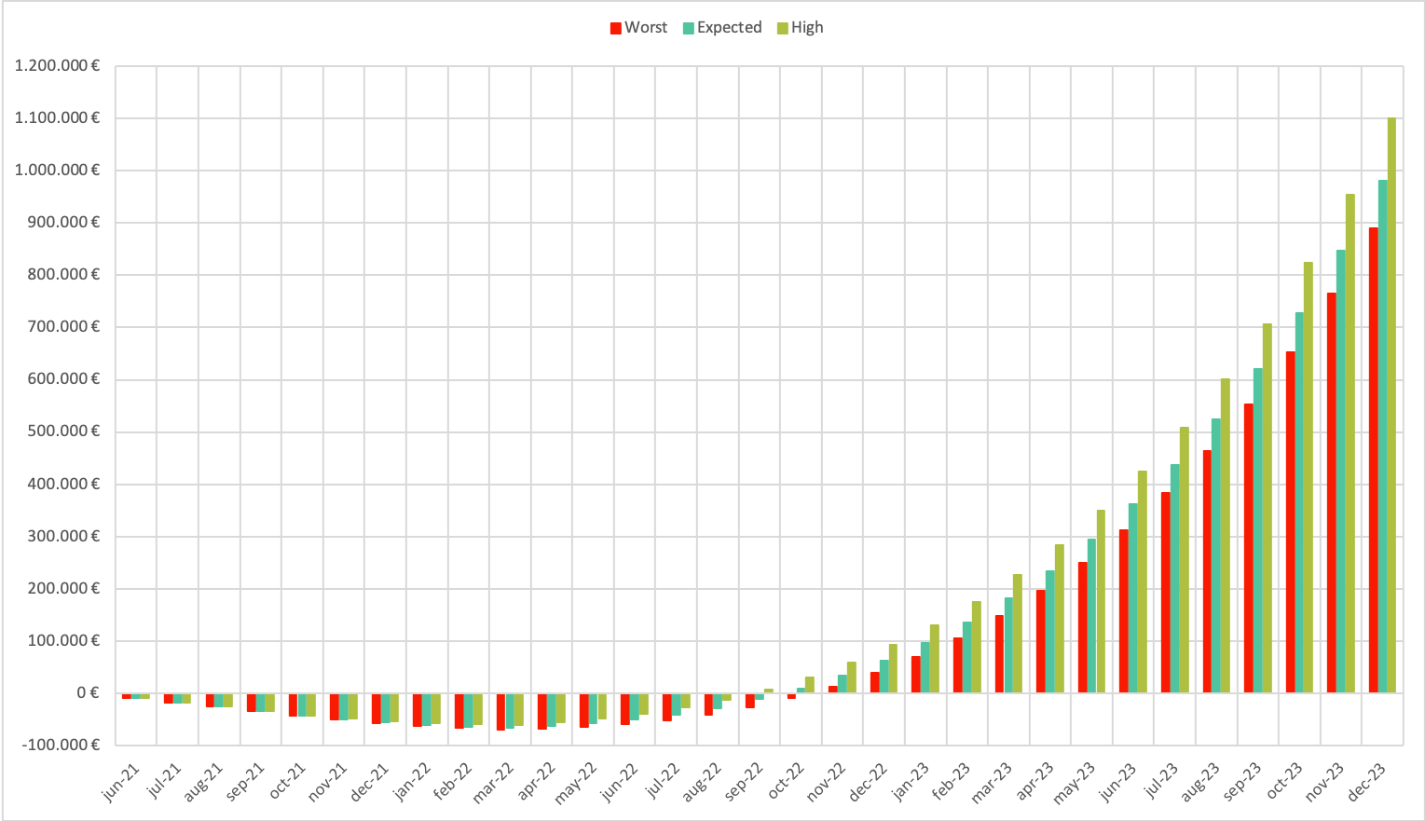
Focus on Profits
High Profits!
A closer look at the profits, shows that after an initial phase of 16-18 months where profits are negative – and it is expected, since our prices are below the average on the market - in November 2022 we will really start to become profitable in all scenarios, and the exponential growth in the profitability is very reassuring.
Moreover, since the scenarios considered don’t differ that much between each others during the negative profits phase - although they consider a substantial difference in the number of acquired customers - we think that our strategy is solid, therefore, we will be able to apply it in our context without changes.

Slide 27

Strengths, Weaknesses, Opportunities and Threats
Strengths
Weaknesses
Lean company, customer oriented
Product that is basically unique in the market
Good team, with both strong technical and business competence
Team member with work experience as DevOps engineer
Penetration pricing strategy
S
W
As a Start-up, we can be seen by customers as inexperienced or unreliable
Challange in the technical realization of the full product, since we use state of the art techniques
Not enough funds yet to invest in the awareness of our product
Opportunities
Threats
High demand in the market for our product
No one is currently selling an automated solution for the disk space issue
Potential first customer interested in our product (Sentia)
MPS market size is growing year after year
O
T
Dynatrace is currently automatically solving a tiny portion of disk space errors: they could improve their system before we will enter in the market
Other companies that are already using knowledge graphs technologies could enter in the market

Slide 28




Our Vision
and Mission
Our Philosophy
What Pushes Us to do Better

Slide 29

We are starting from solving the disk space issue but aiming for the stars: we can take advantage of semantic knowledge graphs and ontology learning to expand and scale in and to other domains, with exponential ease.
Eventually, toot will be able to take on the role of a personal assistant, helping you with whatever is on your task list. Furthermore, we can give reasoned recommendations for any type of question.
Wouldn’t it be nice if you were able to work on the most challenging and personally inspiring projects on your job? To do personally meaningful work?
This would only be possible if there was someone else taking care of the daily tasks, the gear grinding. Fortunately, we know it is possible. That's where toot comes in.
“We will create value for all of us to benefit from.”

Slide 30
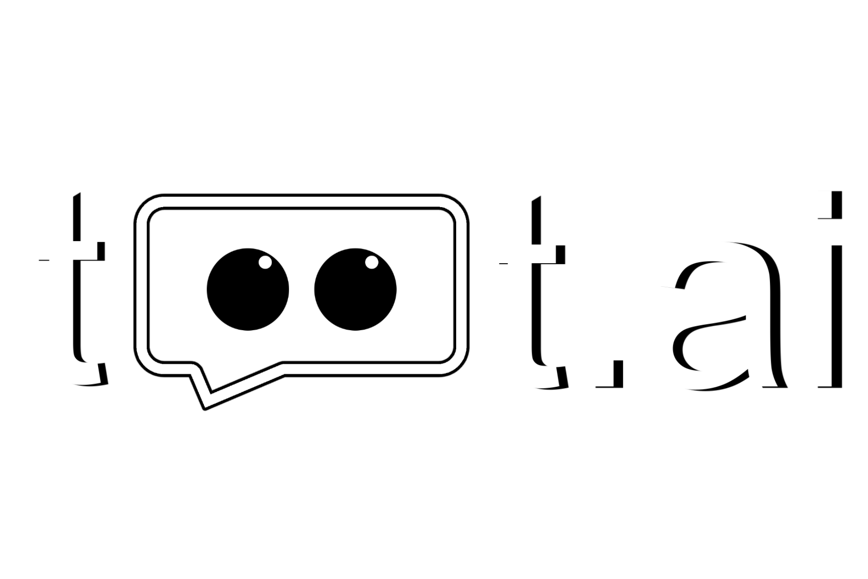
Launch version 1.0 on the market with a 30% discount
Apr 2021
Build our product on a Cloud Platform
Apr
2022
Jun – Sept
2021
Become profitable
We have a working MVP
Apr – Jun
2021
Beta testing and build ontology learning and knowledge extraction
Oct
2021
Remove the 30% discount
Nov
2022
“
We want to help Software and DevOps Engineers to automatically solve disk-space issues so that they can focus on the most interesting aspects of their jobs.
“
Contact Us!
E-mail: otto@toot.ai

Slide 31
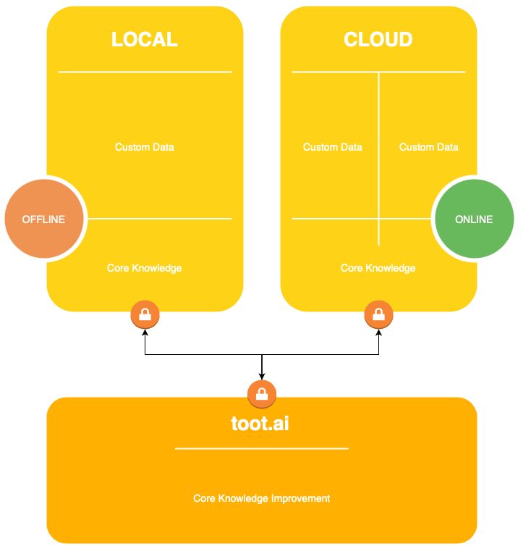
Local / Cloud
Otto will sketch out the graphs.

Slide 32
Core Concepts
Explainability
Friendly UI
I hope and I believe that this Template will your Time, Money and Reputation. Easy to change colors, photos.
I hope and I believe that this Template will your Time, Money and Reputation. Easy to change colors, photos.
Trustworthy
Productivity
Responsibility
I hope and I believe that this Template will your Time, Money and Reputation. Easy to change colors, photos.
Customizable
Friendly UI
Learning
I hope and I believe that this Template will your Time, Money and Reputation. Easy to change colors, photos.

